Slide 1

Past tense (Fortid)

Slide 2
Simple Past – regular verbs
l enjoyed that meal.
They laughed at my joke.
The plane arrived on time.
The lesson started late.
l copied those files you needed.

Slide 3
Simple Past – irregular verbs
I gave her the information.
The school secretary rang back an hour ago.
She told him about the classbook.
A taxi drove her to hospital.
Harold went home early

Slide 4

Simple Past – auxillary verbs
To ask questions or give negative answers we need an auxillary verb such as DO or HAVE. In the past tense, the AUXILLARY is changed and NOT the main verb.
She baked a cake. (simple past)
Did she bake a cake? (question)
She didn’t bake a cake. (negative)

Slide 5
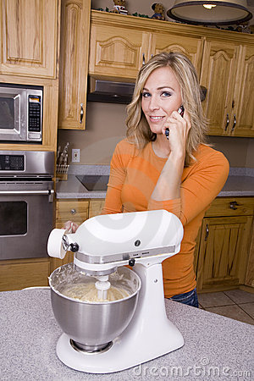
Past – continuous
We use the past continuous (ing) to show something we were doing at a point of time.
She was baking a cake when the phone rang.

Slide 6
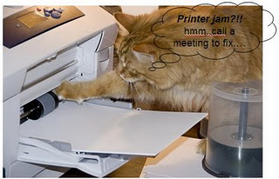
What were you doing when the printer jammed?
I was printing out my essay when the printer jammed.

Slide 7
Useful links to exercises
Regular verbs: http://www.englisch-hilfen.de/en/exercises/tenses/simple_past_statements.htm
All verbs: http://www.englisch-hilfen.de/en/exercises/tenses/simple_past_statements2.htm
Continuous: http://www.englisch-hilfen.de/en/exercises/tenses/past_progressive_statements.htm
http://www.englisch-hilfen.de/en/exercises/tenses/past_progressive_negation_sentences.htm

